Slide 1
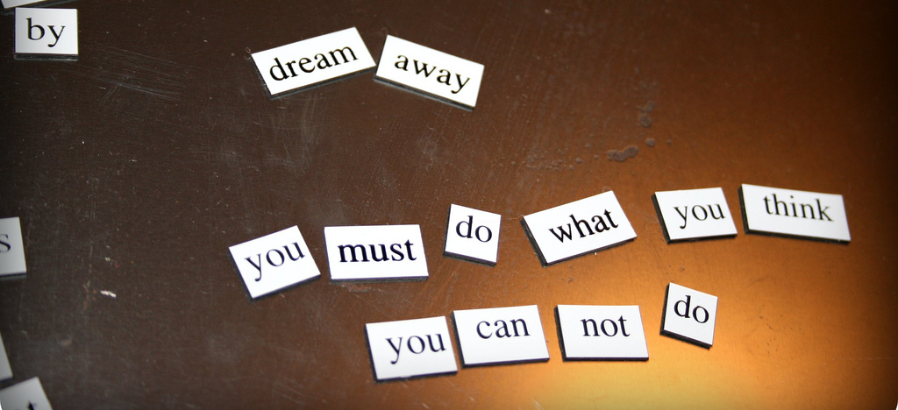

Motives and Goals
[Instructor Name]
[Class Name Section Number]
Notes:
This module provides an overview of the main theories and findings on goals and motivation. It should be taught in less than a single class period (50 – 75 min), with the unit as a whole taking 1-2 class periods.
Technical Note: These slides may contain simple click animation so that you can focus students’ attention on a particular question, a selection of text, or an image and not have them be distracted by reading ahead. You can either preview the sequence of animation by going through the slides in slideshow view, visiting the animations tab, or reviewing the slide notes. In the notes you will see a cue - (Click) – that corresponds to each animation.
You will also find hyperlinks to outside videos at various places in the slides. These hyperlinks are embedded in text and indicated by color and in the notes section.

Slide 2
Overview
Introduction
Origins and Manifestation of Goals
Self-Regulation in Goal Pursuit
Self-Control
Notes:
This slide provides students with an overview of the material that will be covered during the lecture.

Slide 3

Introduction
What are your goals?
Goals require motivation
Intrinsic motivation
Extrinsic motivation
Your goals?
Intrinsic? Extrinsic?
Mixed?
Notes:
This slide encourages students to begin critically thinking about goals.
Warm-up Discussion Question: What are some of your personal goals? For example, what do you hope to achieve while in college? Over the next 10 years? During your lifetime?
Have students jot down some of their goals to refer to during the lecture.
Instructor’s Note: It might be helpful to point out that some goals are short-term, some are long-term, some can be concretely measured (e.g., graduating from college), while other goals cannot (e.g., being happy).
Explanation:
(Click) Goals are defined as the cognitive representation of a desired state (i.e., the picture in your head of where you want to be). Motivation refers to the psychological driving force that enables the pursuit of that goal. There are two primary types of motivation: intrinsic and extrinsic.
Intrinsic motivation stems from the benefits associated with the process of pursuing a goal.
Extrinsic motivation stems from the benefits associated with achieving a goal, such as fame and fortune.
(Click) Discussion Question: Do you see your goals intrinsically motivated, extrinsically motivated, or both?

Slide 4
Overview
Introduction
Origins and Manifestation of Goals
Self-Regulation in Goal Pursuit
Self-Control
Notes:
This slide provides students with an overview of the material that will be covered during the lecture.

Slide 5

Origins and Manifestation of Goals
Goal Adoption
Valuable
Attainable
Notes:
This slide introduces important concepts of the origins and manifestation of goals.
Discussion Topic: Consider the goal you identified during the class warm-up. What are some reasons we adopt goals? Is every goal in our life deliberate, like an item on a wish list of positive outcomes, or might we have subconscious goals we aren’t even aware we’re pursuing?
Explanation:
(Click) Goal adoption is a commitment that stems from a sense that your goal is both valuable and attainable. People tend to adopt goals that are highly likely to bring positive outcomes. This process of committing to a goal can occur with or without conscious deliberation.
Instructor’s Note: The image represents the goal of weight loss—an example that might serve as a vehicle for the discussion of concepts over the next several slides.

Slide 6

Origins and Manifestation of Goals
Consequences of Goal Activation
Behavior
Judgment
Perception
Feelings
Notes:
This slide continues the discussion of goals.
The activation and pursuit of a goal influences many aspects of behavior and judgment, including how we perceive, evaluate, and feel about the world around us (e.g., when you’re thirsty, goal-relevant objects, such as a glass, are viewed more positively than objects that are not relevant, such as a fork).
Discussion Topic: If your goal is weight loss how might your behavior, judgment, perception and feelings be affected?
Examples students generate might include things like: noticing and shopping at farmer’s markets; increased interest in seasonal vegetables, unprocessed and low-fat ingredients; positive feelings about the person on the bus with the “Shop Fresh, Shop Local” tote bag.
Ask students to consider how their own goals affect their behavior, judgment, perception, and feelings.

Slide 7
Overview
Introduction
Origins and Manifestation of Goals
Self-Regulation in Goal Pursuit
Self-Control
Notes:
This slide provides students with an overview of the material that will be covered during the lecture.

Slide 8

Self-Regulation in Goal Pursuit
Notes:
Self-control is the capacity to postpone immediate gratification for the sake of future interests. Some people have a natural ability to exercise self-control more easily than others, which has life-long implications; studies have shown that a stronger self-control leads to greater cognitive and social competence over the course of a lifetime.
The slide contains a video of children trying to practice self-control. Click the play button of the embedded video to view the “marshmallow test”.
Discussion Questions: Do you think you would have eaten the marshmallow when you were a child, or would you have waited? How did different children in the video exercise or try to exercise self-control? What are some ways you exercise self-control in your life?
Instructor’s Note: It might be helpful to point out that ten years after the original marshmallow tests, researchers found that children who were able to wait longer in the experiment performed better academically and socially and had better psychological coping skills as adolescents.
Explanation: In terms of goal achievement, identifying an inherent self-control conflict is likely to influence progress. Specifically, the successful pursuit of a goal in the face of temptation requires an individual to identify impulses that need to be controlled.
(Click) Beyond personal characteristics, the ability to exercise self-control can fluctuate from one context to the next. In particular, exercising self-control drains individuals of the limited physiological and psychological resources required to continue the pursuit of a goal. The exhaustion of those resources is called ego-depletion and makes continuing to exercise self-control in follow-up situations more difficult.

Slide 9
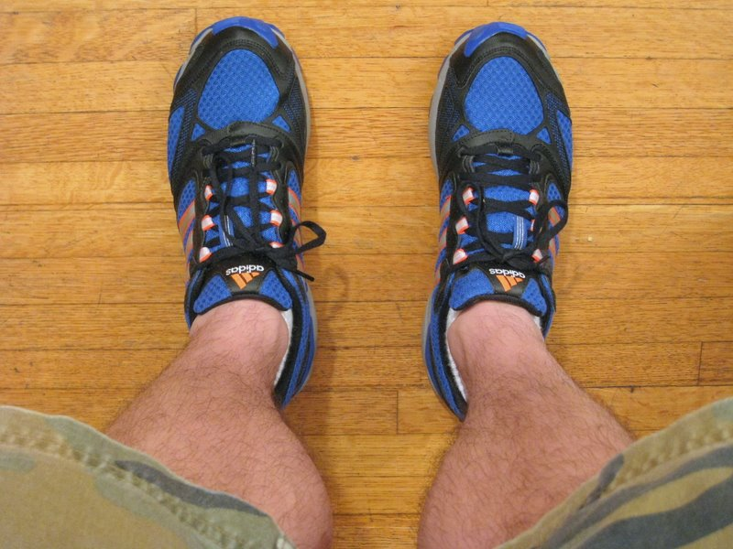
Self-Regulation in Goal Pursuit
Decision
Deliberative phase
Implemental phase ➔
Orientation
Prevention focus
Promotion focus
Notes:
This slide describes the role of self-regulation in the context of goal pursuit.
Self-regulation involves two basic stages associated with two distinct mindsets:
The deliberative phase, in which one decides on a goal to pursue; and
The implemental phase, in which one plans specific actions to progress toward that goal.
Example: Someone whose goal is weight loss might include running shoes in his/her implementation phase – planning to run with co-workers after lunch each day.
Discussion Question: What other things might someone interested in weight loss include in their implementation phase?
Examples students generate might include things like: recruiting a running partner, researching healthy cookbooks, buying a gym membership, etc.)
Research also distinguishes between two self-regulatory orientations:
A prevention focus, which emphasizes safety, responsibility, and security needs, and views goals as “oughts”; and
A promotion focus, which emphasizes hopes, accomplishments, and advancement needs, and views goals as “ideals”.
Further Explanation: Emphasizing potential losses will motivate individuals with a prevention focus, whereas emphasizing potential gains will motivate individuals with a promotion focus.
Instructor’s Note: Here it might be helpful to again ask students to consider their orientation towards their own goals they identified earlier.

Slide 10

Self-Regulation in Goal Pursuit
Cybernetic Process
  Actual Progress vs. ➔ Desired Progress
  Greater-than-expected (coast)
  Lower-than-expected (increase effort)
Highlight & Balance Goals
Notes:
This slide continues the discussion of self-regulation in the context of goal pursuit.
Self-regulation is affected by comparing actual progress to expected progress. In this so-called cybernetic process, a better-than-expected rate of progress toward a goal creates positive feelings, which results in individuals reducing their efforts and “coasting”, whereas a lower-than-expected rate of progress creates negative feelings, resulting in an increase in effort.
Discussion Question: For students who have pursued weight loss or similar goals, have you experienced the kinds of changes in effort described by this cybernetic process?
(Click) Similarly, completed goal actions can also influence self-regulation, depending on whether they signal commitment or progress.
When people interpret their previous actions as a sign of commitment to a goal, they tend to highlight the pursuit of that goal by prioritizing it and putting more effort into it. However, when people interpret their previous actions as a sign of progress, they tend to balance between this goal and others and put less effort into it.
Example:
Considering the goal of weight loss, someone eating a low-calorie meal might view that meal as a goal action that is part of the commitment to losing weight, and adhere to a low-calorie diet. Maybe after a week or two of sticking to that diet and losing a couple pounds, that same person might view the goal action of the low-calorie diet as signaling progress toward the goal, and treat themselves to a dinner of pizza and ice cream—because, generally, the goal is being achieved.

Slide 11
Overview
Introduction
Origins and Manifestation of Goals
Self-Regulation in Goal Pursuit
Self-Control
Notes:
This slide provides students with an overview of the material that will be covered during the lecture.

Slide 12
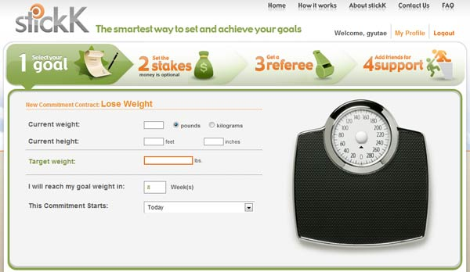
Conflicting Goals and
Self-Control
Counteracting Temptation
  Value
  Pre-commitment
  Reward and Punishment
  Distance
Notes:
This slide continues the discussion of self-control in the context of goals and motivation.
The protection of a goal involves cognitive and behavioral strategies aimed at “counteracting” temptations and pushing oneself toward goal-related choices, such as:
(Click) decreasing the value of temptations and increasing the value of goal-consistent options.
(Click) establishing rewards for goals and penalties for temptations;
(Click) pre-committing to forgo temptations and pursue goals (Click the “Pre-commitment” hyperlink in the slide to open a website focused on goal achievement.)
(Click) or physically distancing oneself from temptations, while making goal-oriented options readily available.
Discussion Question: Back to our weight loss scenario; how might someone pursuing weight loss counteract temptation according to these strategies?
Instructor’s Note: The image is taken from a modern tool to help people achieve their goals; the website stickk.com helps people make pre-commitments as well as establish rewards and punishments.
stickK users set up a "commitment contract" whereby they agree to achieve a certain goal, such as losing weight, exercising more, quitting smoking, or conserving energy. They sign a legally binding contract that will send their money to a third party, whether a specific individual (identified as "Friend” or “Foe") or one of a selection of organizations and charities. Users also have the option of choosing an organization whose views they oppose, referred to as "anti-charities.“

Slide 13
Photo Attribution
Slide 1 | designsbykari http://www.flickr.com/photos/designsbykari/5417652532/ https://creativecommons.org/licenses/by-nc/2.0/
Slide 3 | Photo Credit: University of Denver https://www.flickr.com/photos/38106254@N05/5804925646/ https://creativecommons.org/licenses/by-nc-sa/2.0/
Slide 5 | Photo Credit:Hayley Bouchard https://www.flickr.com/photos/16827363@N00/2945867348/ https://creativecommons.org/licenses/by-nc-nd/2.0/
Slide 6 | Photo Credit: scottroberts https://www.flickr.com/photos/10804390@N00/378758352/ https://creativecommons.org/licenses/by-nc-nd/2.0/
Slide 8 | Photo Credit: pnoeric https://www.flickr.com/photos/44124330110@N01/2327852669/ https://creativecommons.org/licenses/by-sa/2.0/
Slide 11 | Photo Credit: David Gallagher https://www.flickr.com/photos/27109792@N00/4395225943/ https://creativecommons.org/licenses/by-nc-sa/2.0/
Slide 9 | Photo Credit: http://www.stickk.com
Notes:
This slide continues the discussion of self-control in the context of goals and motivation.
The protection of a goal involves cognitive and behavioral strategies aimed at “counteracting” temptations and pushing oneself toward goal-related choices, such as:
(Click) decreasing the value of temptations and increasing the value of goal-consistent options.
(Click) establishing rewards for goals and penalties for temptations;
(Click) pre-committing to forgo temptations and pursue goals (Click the “Pre-commitment” hyperlink in the slide to open a website focused on goal achievement.)
(Click) or physically distancing oneself from temptations, while making goal-oriented options readily available.
Discussion Question: Back to our weight loss scenario; how might someone pursuing weight loss counteract temptation according to these strategies?
Instructor’s Note: The image is taken from a modern tool to help people achieve their goals; the website stickk.com helps people make pre-commitments as well as establish rewards and punishments.
stickK users set up a "commitment contract" whereby they agree to achieve a certain goal, such as losing weight, exercising more, quitting smoking, or conserving energy. They sign a legally binding contract that will send their money to a third party, whether a specific individual (identified as "Friend” or “Foe") or one of a selection of organizations and charities. Users also have the option of choosing an organization whose views they oppose, referred to as "anti-charities.“

